Slide 1
Evolution of Cybersecurity: From Creeper to Quantum Threats: A journey from Creeper to AI
A 3MTT Cybersecurity Mini Project by:
Shettima mohammed ibraheem

Slide 2
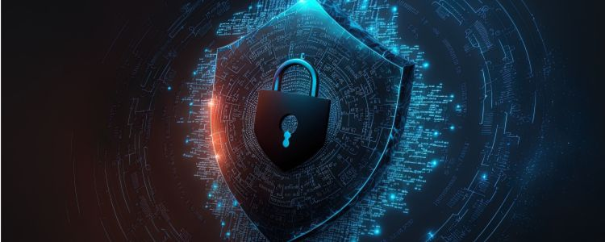
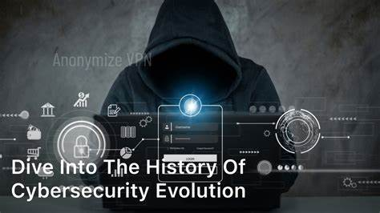
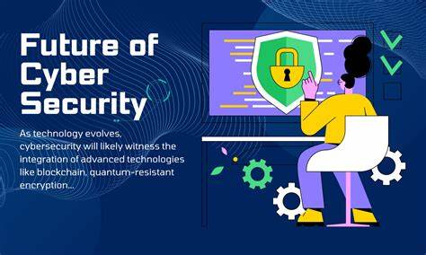
Introduction
Cybersecurity has evolved from basic antivirus to AI-driven defense. Let’s explore its journey

Slide 3
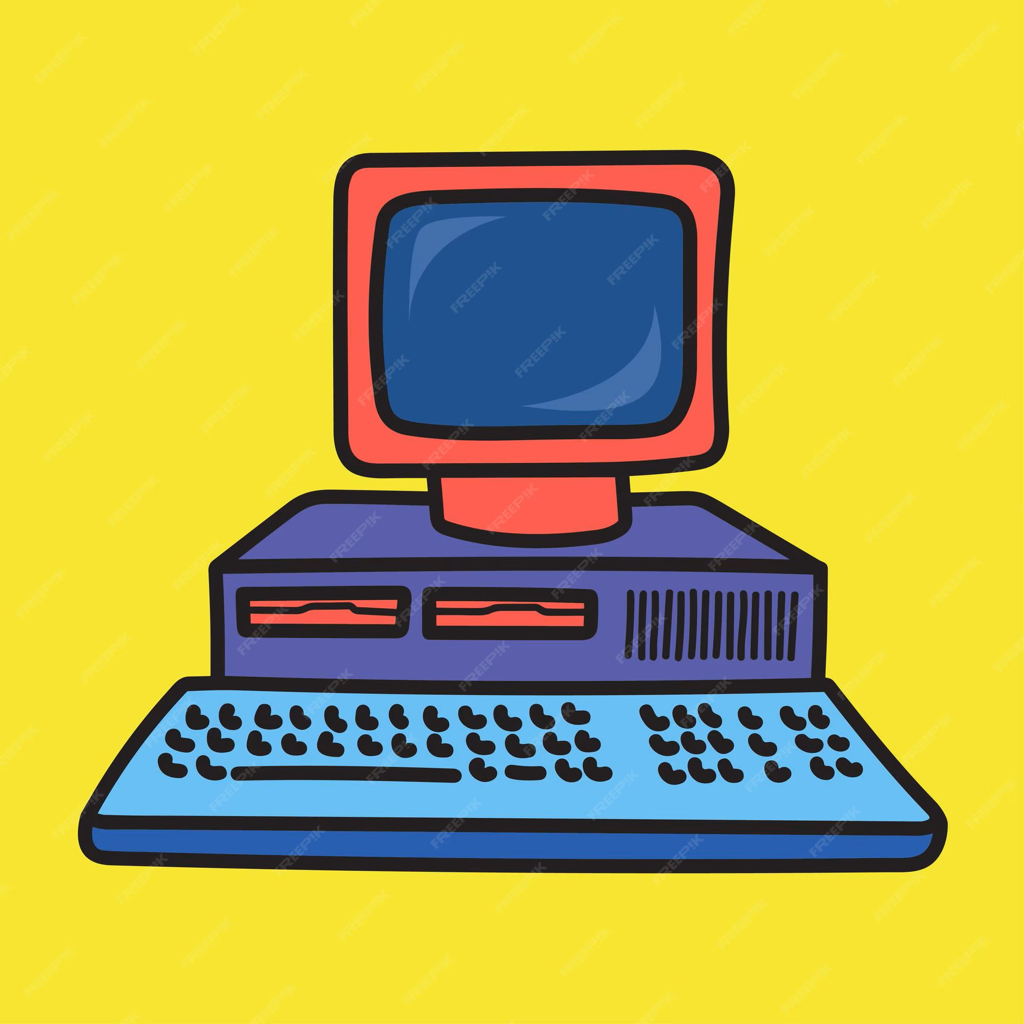

1970s: The Birth
1971: Creeper Virus → First self-replicating program.
1976: Diffie-Hellman → Public-key cryptography.

Slide 4
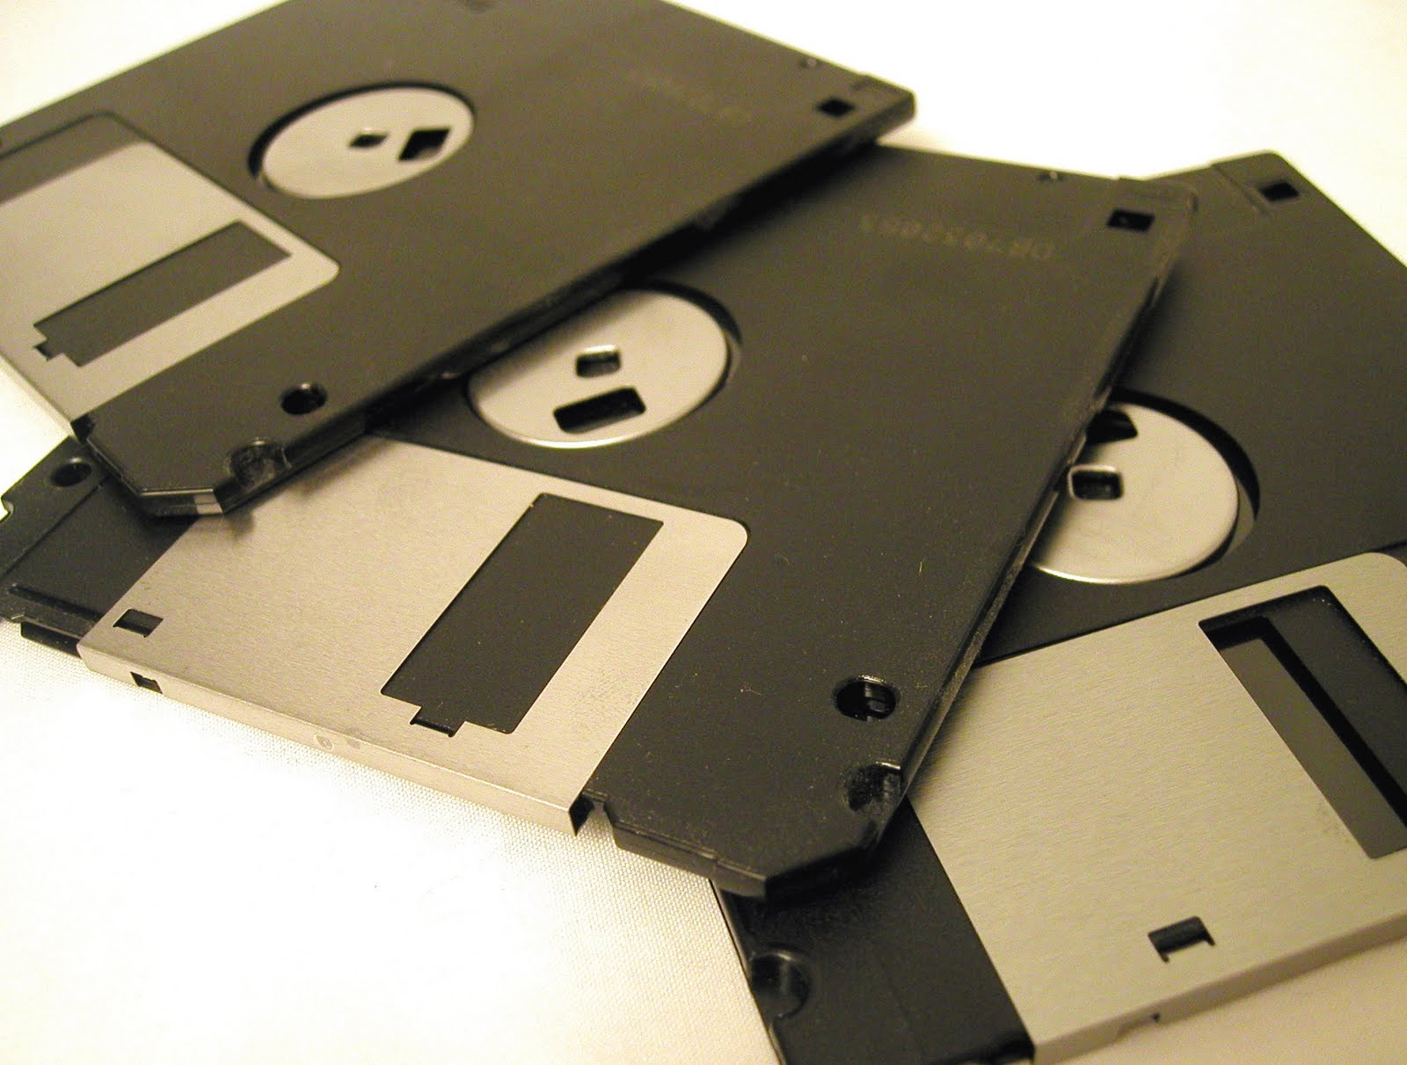
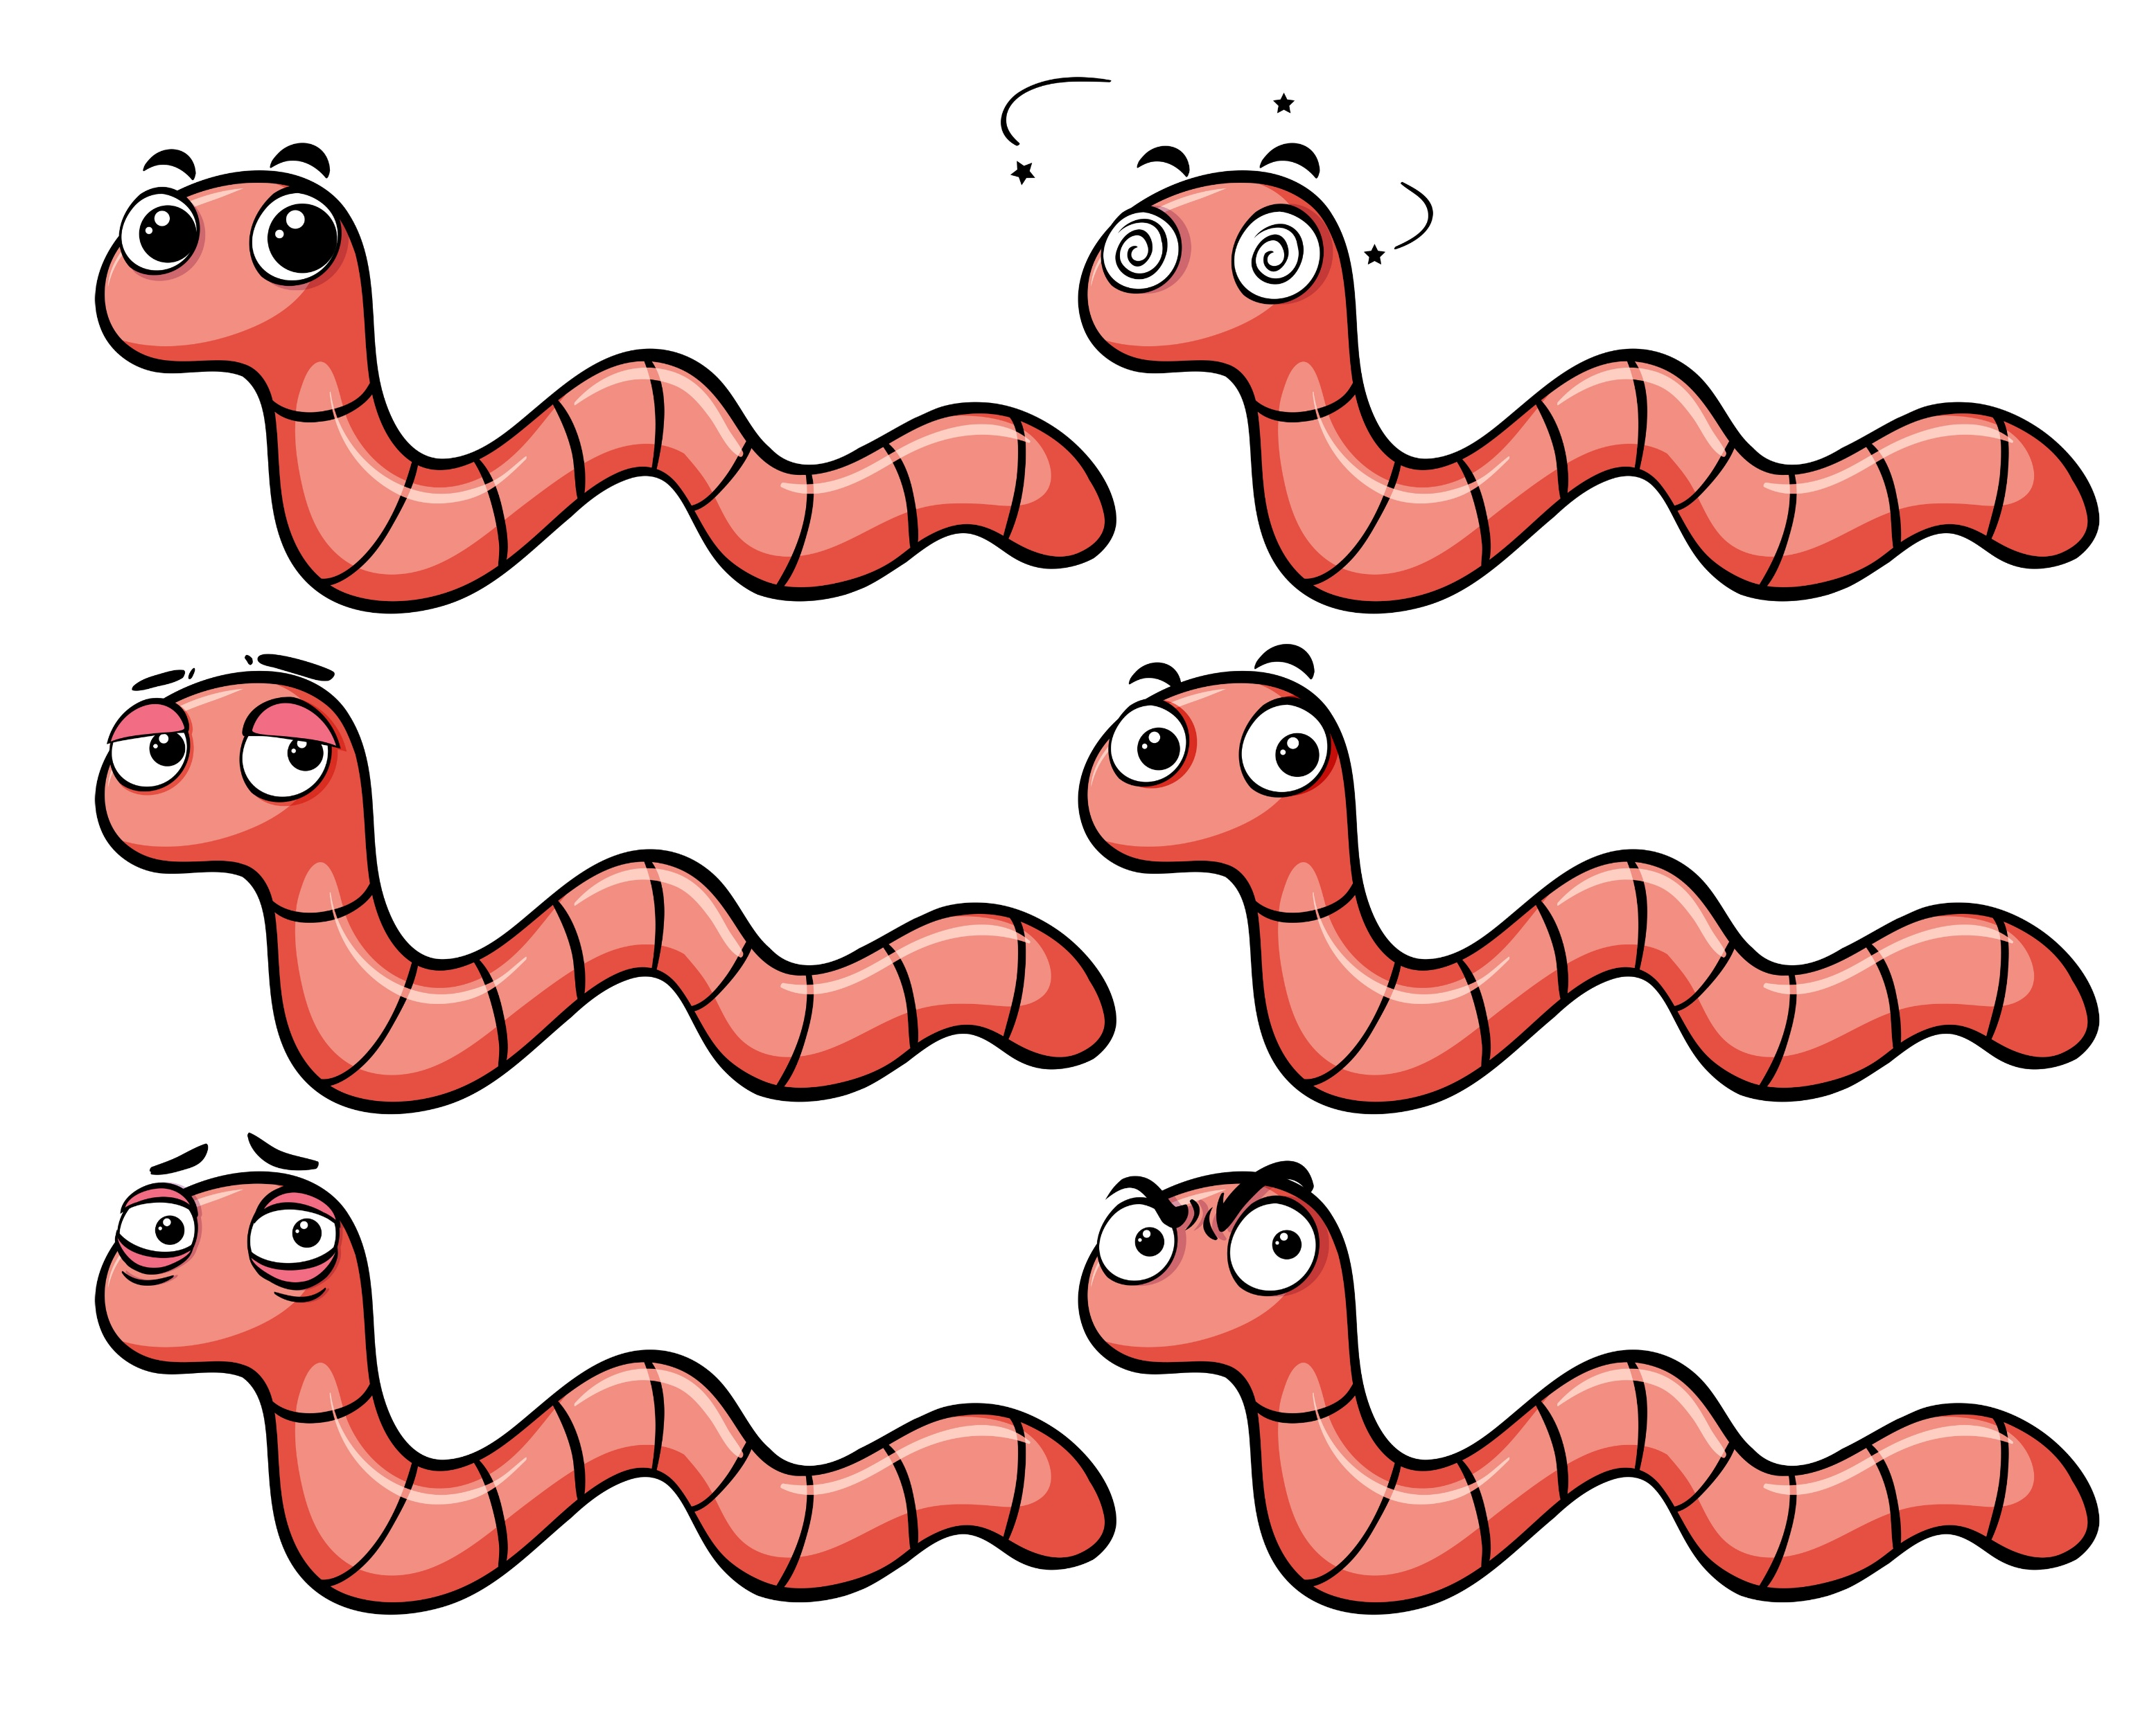
1980s: Malware Era
1983: Term "Computer Virus" coined.
1988: Morris Worm → First major internet worm.

Slide 5
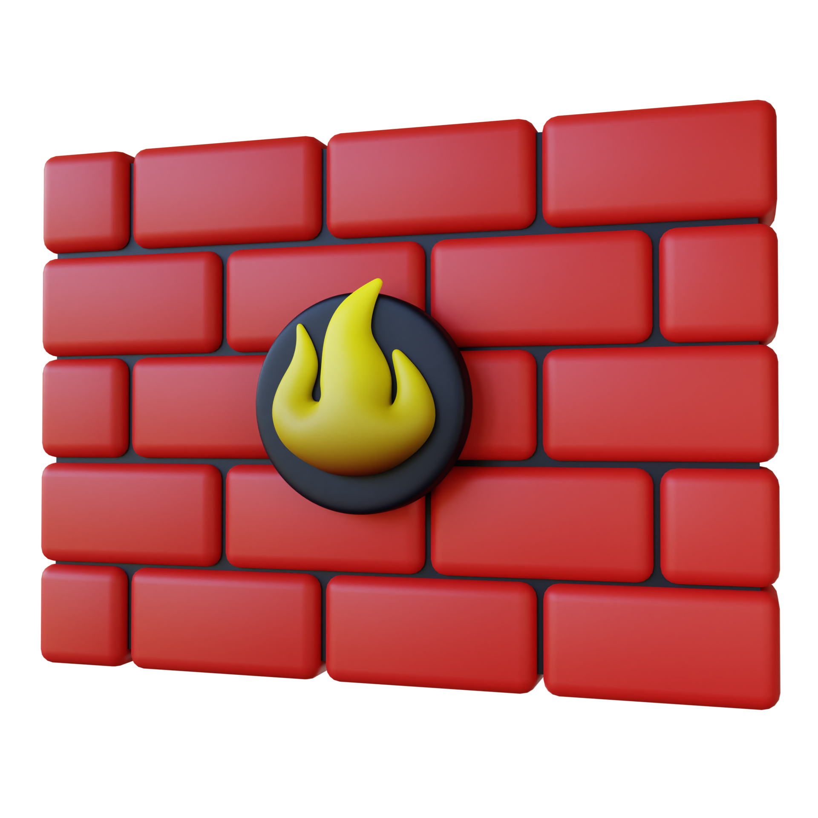

1990s – Internet Boom
1990: Firewalls → Network protection.
1999: Melissa Virus → Email-based threat.

Slide 6

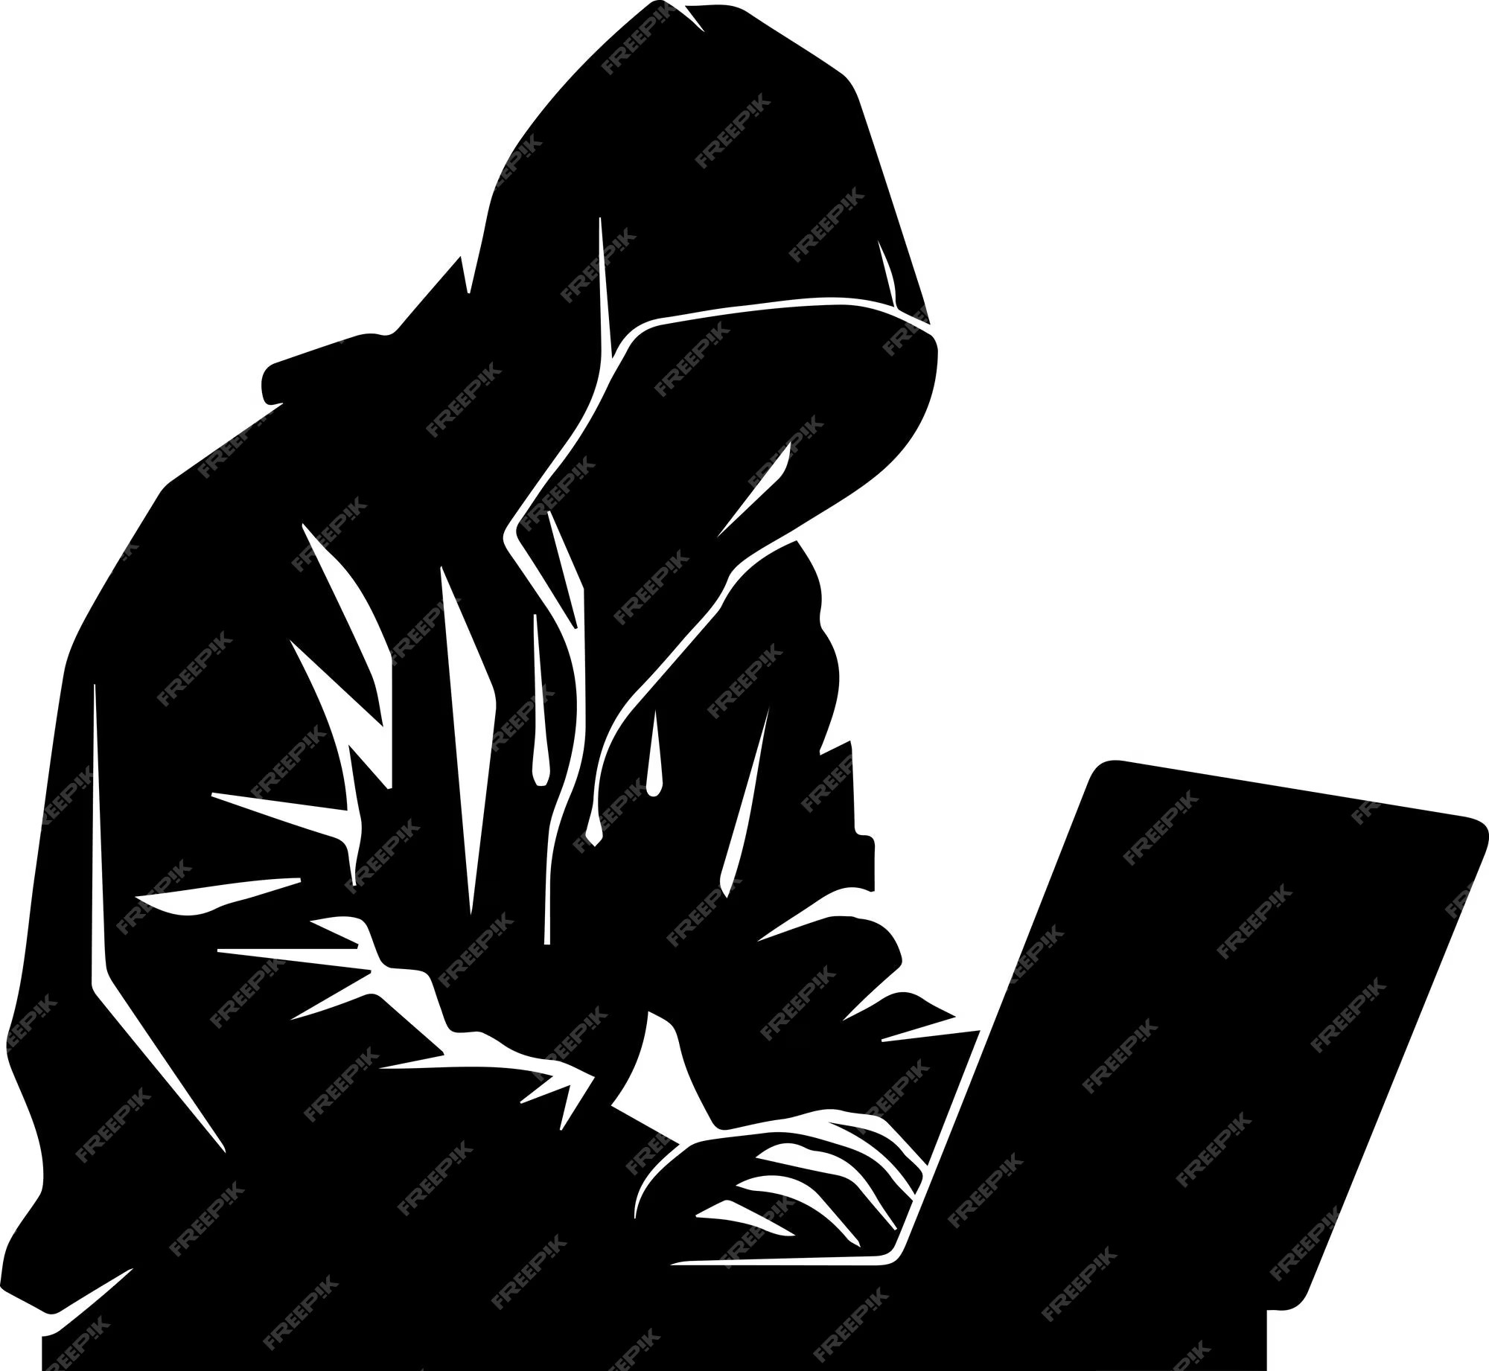
2000s – Global Cybercrime
2000: ILOVEYOU Worm → $15B damages.
2007: APT1 → State-sponsored hacking.

Slide 7
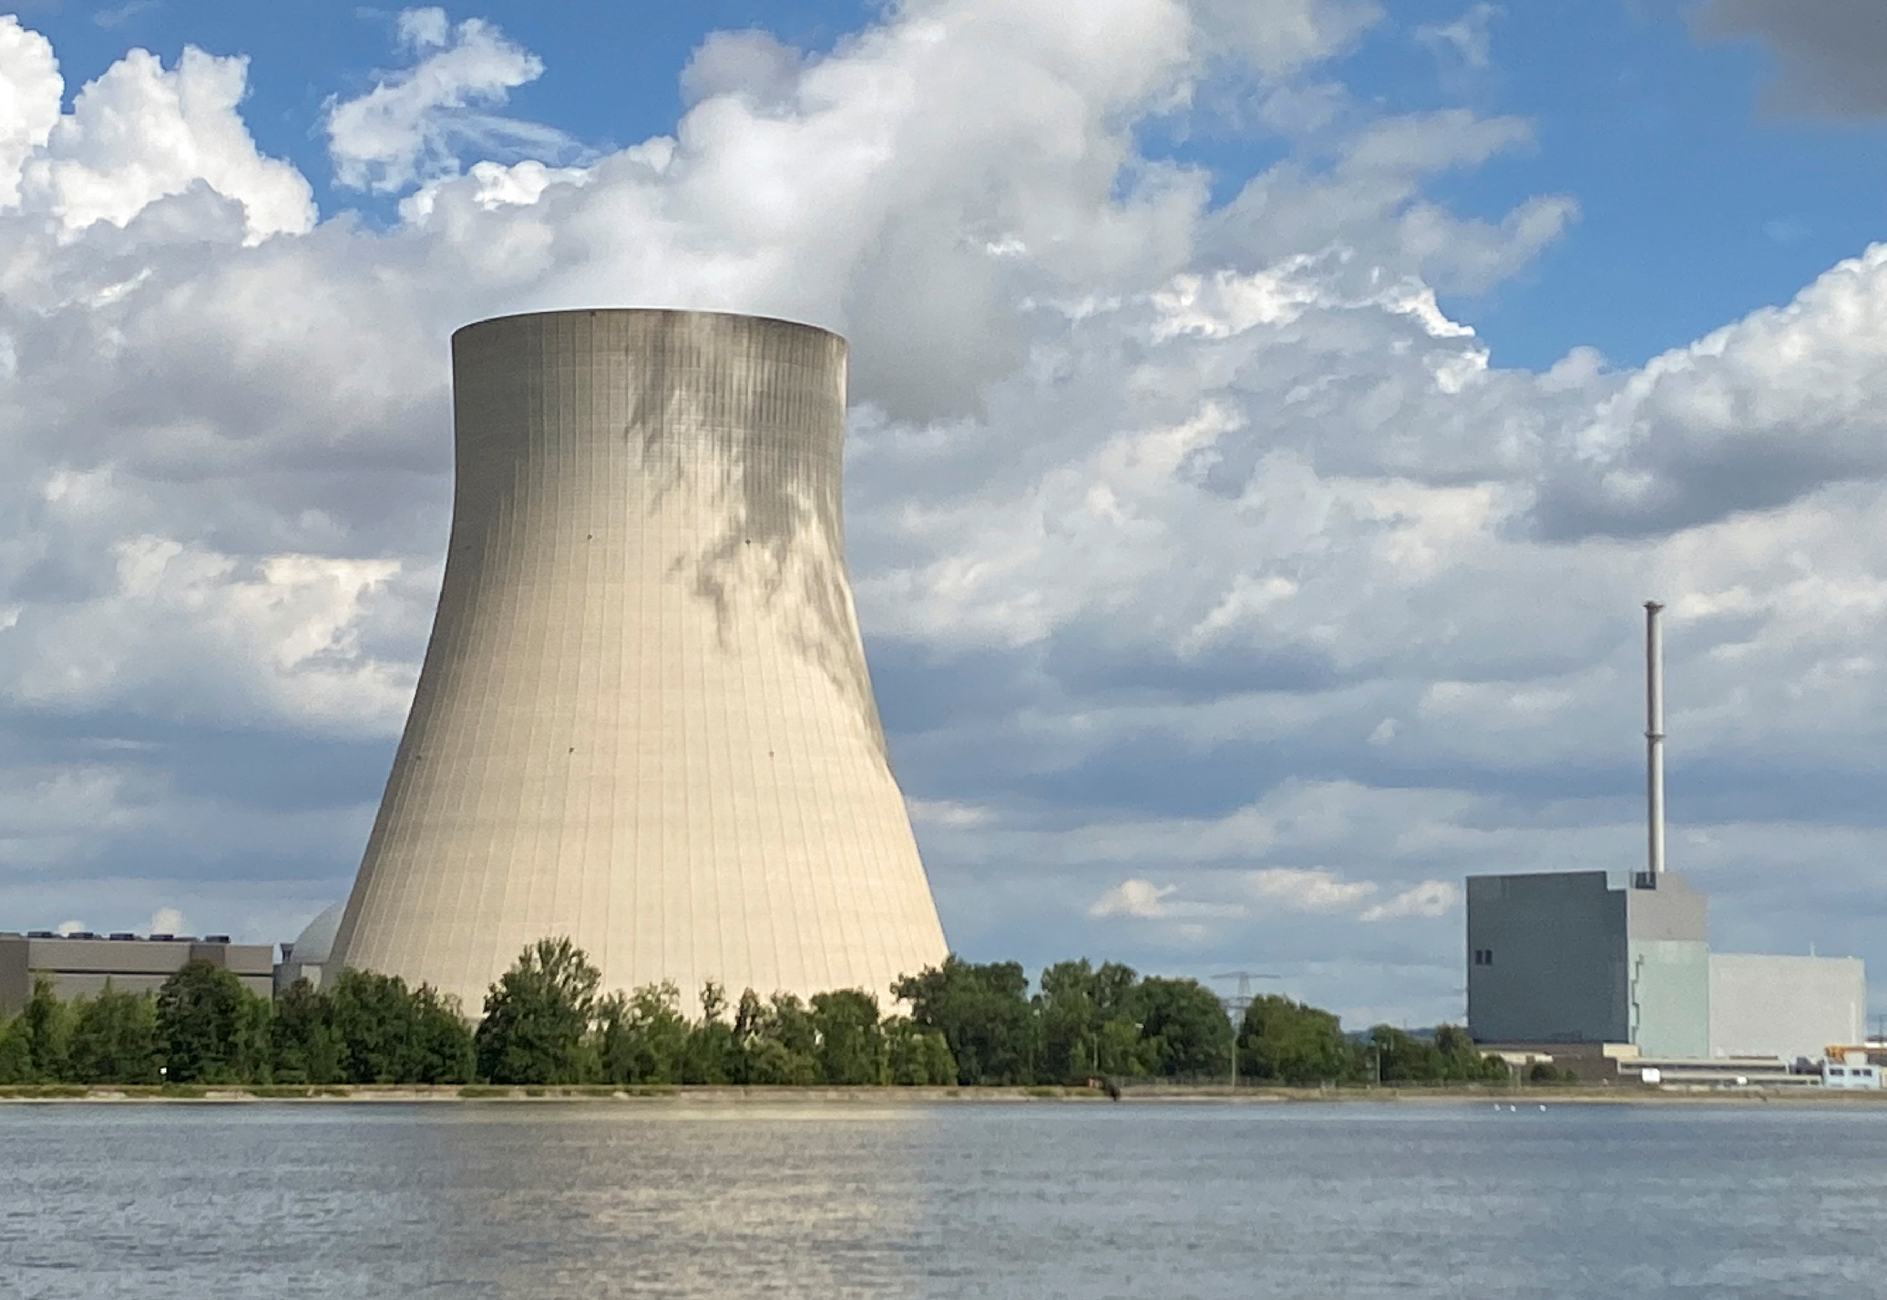
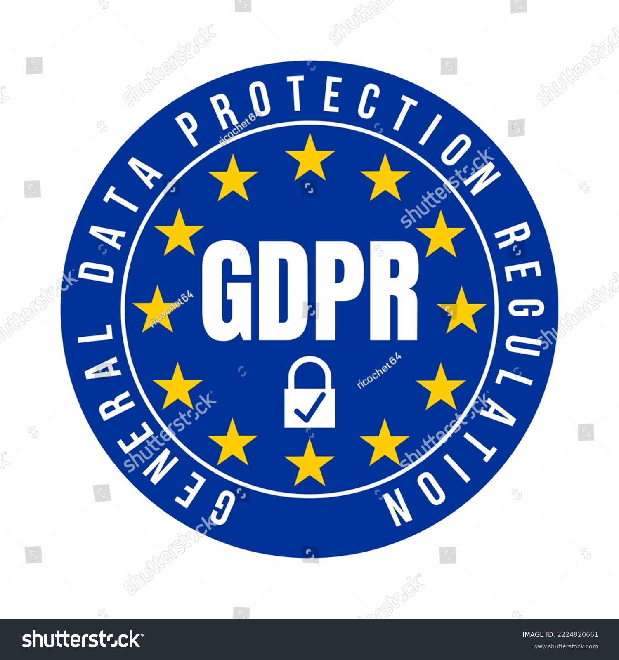
2010s – Regulations & Warfare
2010: Stuxnet → Cyber-weapon.
2018: GDPR → Data privacy law.

Slide 8
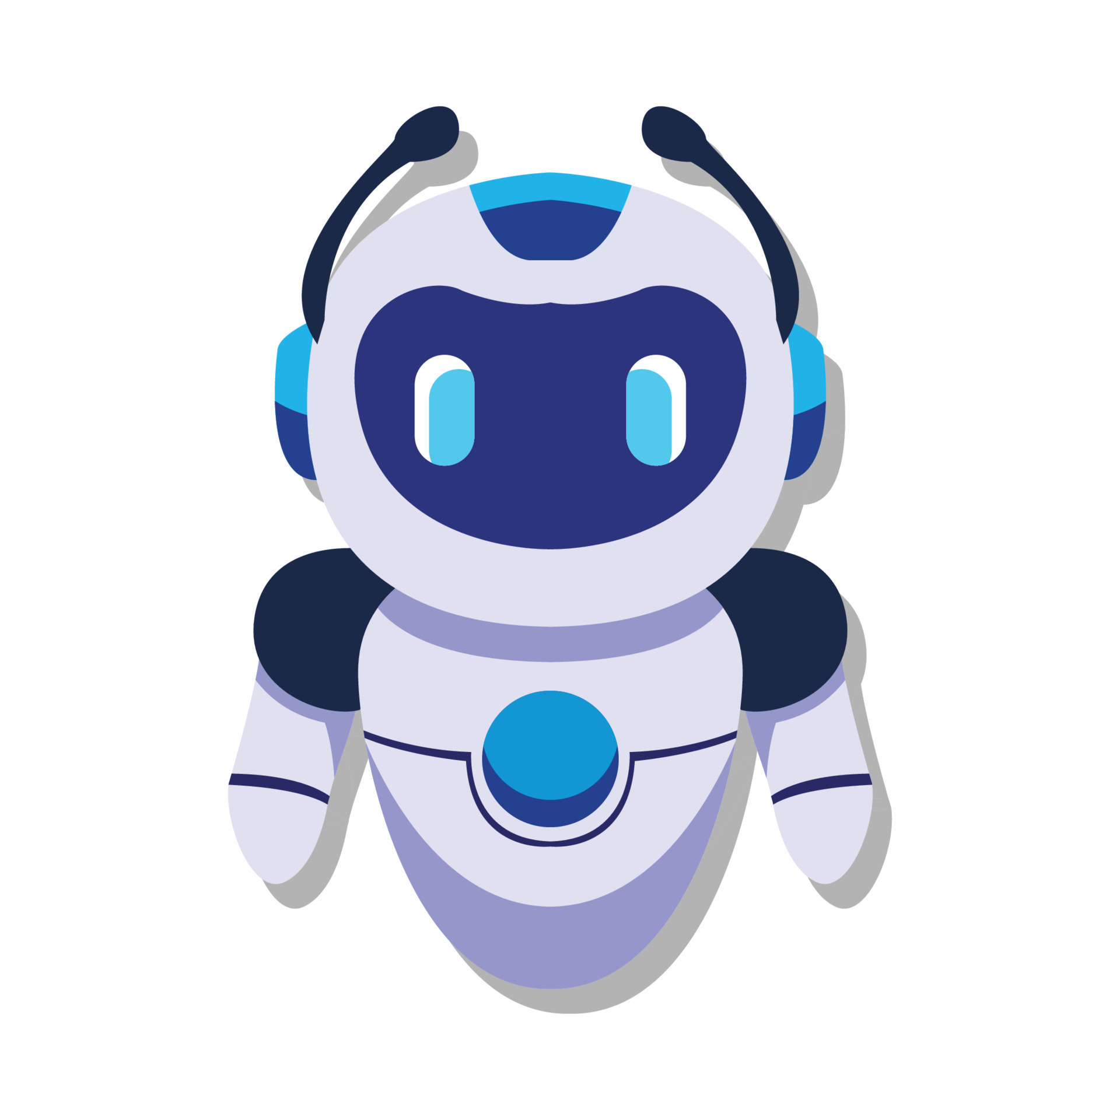
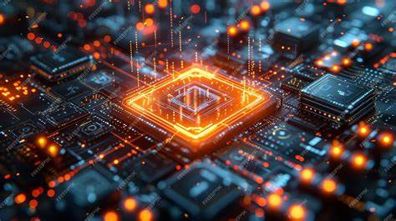
2020s – AI & Quantum Threats
2021: Colonial Pipeline → Ransomware attack.
2024: NIST → Post-quantum crypto.

Slide 9
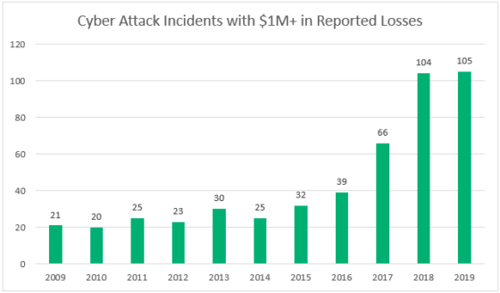
Key Trends
Reactive → Proactive defense.
2. Rise of nation-state attacks.
3. AI vs. AI cybersecurity arms race.

Slide 10
Lessons Learned:
“Cybersecurity is a never-ending race – innovate or perish!“
"Human error is the weakest link."

Slide 11
THANK YOU
Stay secure!
Fellow ID
FE/23/22885073
Cohort 3

Slide 12
Key Takeaways 1. The Importance of Proactive Defense Events: Creeper Virus (1971), Morris Worm (1988), WannaCry (2017)
Lesson
Early threats like Creeper and Morris Worm exposed the need to move from reactive fixes (e.g., antivirus) to proactive defense (e.g., firewalls, intrusion detection).
WannaCry ransomware showed the risks of unpatched systems, emphasizing patch management and threat hunting.
Impact
Adoption of Zero Trust frameworks ("never trust, always verify").
Rise of AI-driven tools for predictive threat analysis.

Slide 13
2. Human Error is the Weakest Link Events: Melissa Virus (1999), ILOVEYOU Worm (2000), Phishing Attacks (2020s)
Lesson
Impact
Melissa and ILOVEYOU exploited human curiosity via email, proving that social engineering is often more effective than technical hacking.
Mandatory security awareness training for employees.
Tools like email filters, multi-factor authentication (MFA), and simulated phishing drills.

Slide 14
3. Critical Infrastructure is a Prime Target Events: Stuxnet (2010), Colonial Pipeline (2021)
Lesson
Impact
Cyberattacks can disrupt physical systems (e.g., nuclear facilities, fuel pipelines).
Governments now prioritize OT/ICS security (Operational Technology/Industrial Control Systems).
Regulations like the U.S. Cybersecurity & Infrastructure Security Agency (CISA) mandates.

Slide 15
4. Global Collaboration is Essential Events: APT1 (2007), SolarWinds Hack (2020)
Lesson
Impact
State-sponsored attacks (e.g., APT1) and supply chain breaches (SolarWinds) require cross-border cooperation.
Initiatives like INTERPOL’s Cybercrime Directorate and NATO’s Cyber Defense Pledge.
Public-private partnerships (e.g., Cyber Threat Alliance).

Slide 16
5. Privacy Regulations Are Non-Negotiable Events: GDPR (2018), Facebook-Cambridge Analytica Scandal (2018)
Lesson
Impact
Data misuse erodes trust and enables manipulation.
Global adoption of privacy laws (GDPR, CCPA, Nigeria’s NDPR).
Companies now prioritize Privacy by Design and data minimization.

Slide 17
6. Cybercrime Has Real-World Costs Events: ILOVEYOU (15Bloss),ColonialPipeline(15Bloss),ColonialPipeline(4.4M ransom), MOVEit Hack (2023)
Lesson
Impact
Cyberattacks cripple economies and daily life (e.g., fuel shortages, healthcare disruptions).
Growth of cyber insurance markets.
Boardrooms now treat cybersecurity as a business risk, not just an IT issue.

Slide 18
7. Innovation Drives Defense Events: Diffie-Hellman (1976), SSL (1995), Post-Quantum Cryptography (2024)
Lesson
Impact
Events: Diffie-Hellman (1976), SSL (1995), Post-Quantum Cryptography (2024)
Quantum-resistant algorithms are now in development.
Tools like homomorphic encryption (processing data without decrypting it).

Slide 19
8. The Double-Edged Sword of AI Events: ChatGPT (2023), Deepfakes (2020s)
Lesson
Impact
AI automates defenses (e.g., anomaly detection) but also powers attacks (e.g., deepfake phishing).
Ethical frameworks for AI in cybersecurity (e.g., bias mitigation, transparency).
Tools like AI-generated threat intelligence and behavioral biometrics.

Slide 20
9. Cyber Warfare is the New Battlefield Events: Stuxnet (2010), Russian Election Interference (2016), Ukraine Cyberattacks (2022)
Lesson
Impact
Nations now use cyberattacks for espionage, sabotage, and psychological warfare.
Militaries have cyber warfare units (e.g., U.S. Cyber Command).
Cyber norms debated at the UN (e.g., banning attacks on hospitals).

Slide 21
10. Resilience Over Perfection Events: All major breaches (e.g., Equifax, Marriott)
Lesson
Impact
No system is 100% secure, so focus on rapid recovery over perfect prevention.
Adoption of disaster recovery plans and incident response teams.
Red team/blue team exercises to stress-test defenses.

Slide 22
Key Takeaways for the Future
Adapt or Perish: Cybersecurity must evolve as fast as technology (e.g., IoT, quantum computing).
Think Globally: Attacks cross borders, so collaboration is key.
People Matter: Train users, hire diverse talent, and foster a security-first culture.
Ethics Matter: Balance surveillance with privacy, and AI with accountability.

Slide 23
Deliverable
Timeline Structure
1. 1970s: The Birth of Cybersecurity
🦠 1971: Creeper Virus – First self-replicating program.
🔒 1976: Diffie-Hellman – Foundation of modern encryption.
2. 1980s: Rise of Malware
🦠 1983: Term “Computer Virus” coined.
🦠 1988: Morris Worm – Disrupted 10% of the internet.
3. 1990s: Defending the Internet
🔒 1990: Firewalls – Network protection mainstream.
🦠 1999: Melissa Virus – Macro virus via email.
4. 2000s: Global Cybercrime
🦠 2000: ILOVEYOU Worm – $15B in damages.
📜 2004: PCI DSS – Secure payment standards.
🦠 2007: APT1 – State-sponsored hacking group.
5. 2010s: Cyber Warfare & Privacy
🦠 2010: Stuxnet – First cyber-weapon (Iran nuclear facilities).
📜 2018: GDPR – EU data privacy law.
🦠 2017: WannaCry – Global ransomware attack.
6. 2020s: AI, Zero Trust & Quantum
🔒 2020: Remote Work Surge – Cloud security demand (COVID-19).
🦠 2021: Colonial Pipeline – Ransomware disrupts U.S. fuel supply.
🔒 2022: Zero Trust – “Never trust, always verify” adopted.
🤖 2023: AI Threats – ChatGPT phishing, deepfakes.
🔒 2024: Quantum Readiness – NIST post-quantum crypto standards.

